Slide 1
Spam & Unsolicited Commercial Communications

Slide 2
INTRODUCTION
Notes:
Or should the title be Multi-Pronged Approach?

Slide 3
INTRODUCTION
Spam is Generally:
Unsolicited commercial electronic messages (UCE) sent via electronic mail (e-mail; ie junk mail) or mobile phones
Source of e-mail addresses obtained by spammers usually from: Addresses of recipients from web pages, databases, guessing common names, domains, dictionary attacks

Slide 4
INTRODUCTION
Birth of SPAM:
SPAM was born in Phoenix, Arizona, in 1994
Two lawyers sent advertisement on internet to 8000 usenet newsgroups and it reached to 20 million quickly resulting in crashing of ISP’s primitive servers
A new marketing technique was born

Slide 5
INTRODUCTION
Birth of SPAM:
Jump in e-mail traffic from 7% in 2001 to 50% in 2003 in some countries
IDA study: 1.33 million people spammed in Singapore in 2003

Slide 6
(then) IDA-AGC PROPOSED
LEGAL FRAMEWORK ON SPAM
Notes:
Or should the title be Multi-Pronged Approach?

Slide 7
IDA-AGC PROPOSED
LEGAL FRAMEWORK ON SPAM
Actions Taken:
Public consultation: May - June 2004
Collaboration with ISP (internet service providers), CASE (consumer association of Singapore), DMAS (direct marketing association of Singapore), SBF (Singapore Business Federation), SiTF (Singapore infocomm technology federation; now called SGTech) (public-private sector partnership)
Idea is to introduce a multi-pronged approach to fight e-mail SPAM

Slide 8
IDA-AGC PROPOSED LEGAL
FRAMEWORK ON SPAM
Definition of SPAM under IDA:
SPAM = unsolicited commercial e-mail messages
E-advertising = UCE +
(a) opt-out option (functional)
(b) appropriate labelling e.g.. Advertising [ADV]
Commercial communications exclude communications
such as those between:
Private individuals
Government to citizen communications
Appeals for donations by charities/religious organization
Messages which are purely factual in nature.

Slide 9
IDA-AGC PROPOSED
LEGAL FRAMEWORK ON SPAM
Simple Diagram Differentiating UCE:
SPAM
(-) UCE
[Bad SPAM]
(+) UCE
[e-advert]

Slide 10
S’PORE PROPOSED LEGISLATION: AN “OPT-OUT” OPTION
Notes:
Or should the title be Multi-Pronged Approach?

Slide 11
EVALUATING IDA-AGC PROPOSAL: AN “OPT-OUT” OPTION
“Opt-Out” System:
Definition:
A distribution model of sending unsolicited e-mail
and allowing the recipient to request removal
Permits sender to send unsolicited commercial e-mails
to the intended recipients until such time they are
asked by the recipients to stop sending

Slide 12
IDA-AGC PROPOSED LEGAL FRAMEWORK ON SPAM
Proposed Legislation is not against unsolicited commercial e-mail (UCE) if it has an opt-out regime:
Opt-out regime
each UCE should have a valid return e-mail address
other languages + English language
opt-out mechanism should be functional
sender must comply with opt out request within a
certain time frame.
the sender should not pass on the recipient e-mail to
other business partners.

Slide 13
S’PORE PROPOSED LEGISLATION: AN “OPT-OUT” OPTION
Requirements:
Labelling Standards:
Subject titles should not be misleading
Subject titles should contain [ADV] – advertisement
e-mail messages should not contain a false header
e-mail messages should have a genuine e-mail address or postal address.

Slide 14
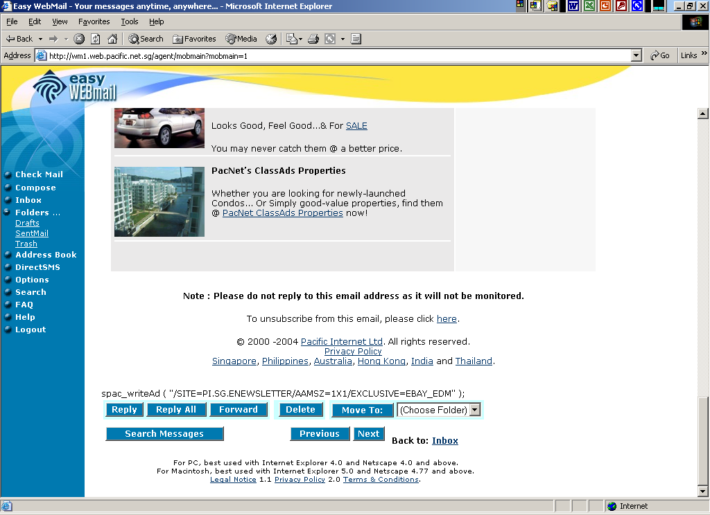
S’PORE PROPOSED LEGISLATION: AN “OPT-OUT” OPTION
Notes:
Source: http://wm3.web.pacific.net.sg/agent/mobmain?mobmain=1

Slide 15
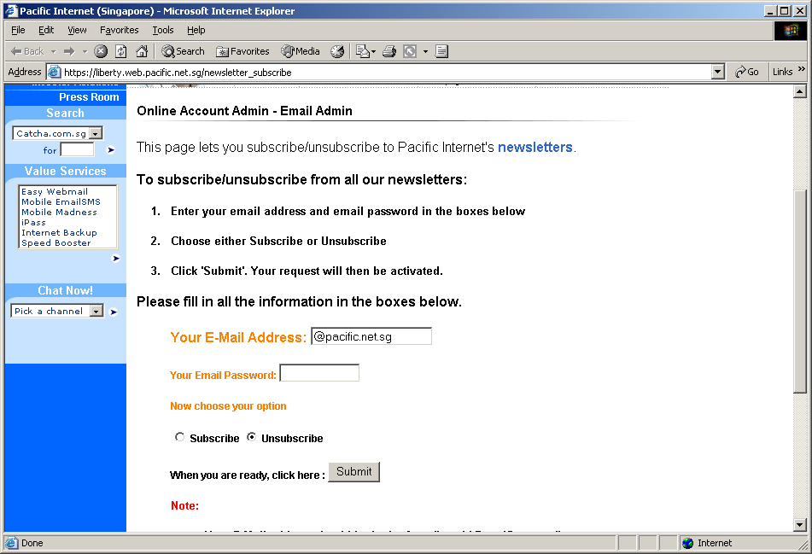
S’PORE PROPOSED LEGISLATION: AN “OPT-OUT” OPTION

Slide 16
EVALUATING IDA-AGC PROPOSAL: Compare with OPT-In option
“Opt-In” System:
Sender cannot send any unsolicited commercial
communications by e-mail until such time the intended
recipient indicated to the sender he is willing to receive
such communications
Characterized by recipients having signed up at websites,
special advertisement banners or marketing channels.
Those who signed up have thus "opted-in”. Any e-mails sent
would not be considered unsolicited
Favours the consumer? Only by Consent
Notes:
An Opt-in regime on the other hand is characterised by recipients having signed up at websites, special advertisement banners or other marketing channels for promotional information about one or more categories of products or services. Those who signed up have thus "opted in". Any e-mails sent as a result would not be considered unsolicited

Slide 17
EVALUATING IDA-AGC PROPOSAL: AN “OPT-OUT” OPTION
“Opt-In”:
Legal uncertainty over what constitutes consent and opt-in assent.
Unwanted e-mail bulk remains
Less marketing opportunities.
Extraterritorial hiccups (not effective due to lack of jurisdiction if spam from outside Singapore)
“Opt-Out”:
Business friendly
Legitimizes SPAM?
Identifying and abuse of “live” address
Proliferation of SPAM
Notes:
Opt-In
Difficult to ascertain what amounts to implicit consent by recipient to want to receive unsolicited commercial communications by email.
Denial of opportunities and access of information to consumers. Hence, not totally pro-consumer.
Difficult for new firms to compete in the market. Since the effectiveness of Internet marketing is being curbed and denied to innovative firms.
The opt-in emails constitute the bulk of unwanted email, and does not in any way reduce the number of emails, hence will not solve the problem of time and space wastage as posed by SPAM.
As long as the spam originates from outside Singapore, opt-in regime will not be effective due to the lack of jurisdiction over extraterritorially.

Slide 18
EVALUATING IDA-AGC PROPOSAL: AN “OPT-OUT” OPTION
Advantages of Opt-Out System:
Reduce burden on businesses in complying with regulations.
Avenue for conducting legitimate businesses.
Consumers enjoy free access to information
Consumers enjoy option to prohibit and select information.
Minimum standards/requirements in place!

Slide 19

EVALUATING IDA-AGC PROPOSAL: AN “OPT-OUT” OPTION
Minimum standards of Opt-Out System:
Valid e-mail address for recipient to send for opting out
At least one set of opt-out instructions in English
Functional
No transfer of email address by sender
Specified time frame

Slide 20
IDA-AGC PROPOSAL :
APPLICATION OF LEGISLATION
Application of Legislation:
Apply to SPAM also transmitted in “bulk” – but subjective test OR by reference to a minimum numerical threshold.
Apply to SPAM originating from or received in Singapore
(minimize the risk that Singapore may become a spam hub)
The merchant or business commissioning or procuring
spam should also be made liable for unlawful SPAM

Slide 21
SPAM CONTROL ACT 2007
The Act came into effect on 15 June 2007
Parliament accepted almost entirely the proposals made by the IDA-AGC joint committee
The Act offers a framework to better manage SPAM as legal guidelines are reasonably easy for marketers to follow.

Slide 22
SPAM CONTROL ACT 2007
Users who do not want to continue receiving SPAM must unsubscribe (opt-out scheme) and any business sending out such messages must provide such an avenue structured in a “consumer friendly” fashion
A marketer who continues to SPAM those who unsubscribe will face potential financial penalties of $25 for each e-message up to a total of $1m

Slide 23
S’PORE PROPOSED LEGISLATION: LEGAL ACTIONS &
OTHER OBLIGATIONS
Notes:
Or should the title be Multi-Pronged Approach?

Slide 24
S’PORE PROPOSED LEGISLATION: LEGAL ACTIONS
Role of ISP
ISP which have suffered loss or damage as a result
spamming activities be given the right to commence
civil action in court
Remedies include:
Damages for pure economic loss suffered
costs and expenses of the action

Slide 25
S’PORE PROPOSED LEGISLATION: OTHER OBLIGATIONS
Self-regulatory Code of Practices
(provide minimum standards of
technical SPAM control and best practice)
ISP actions to curb SPAM in Singapore
Provide clear feedback procedures for subscribers
Make info available for subscribers to manage SPAM
Introduce technical measures to manage SPAM
Implement clear policies to discourage subscribers from using ISP facilities for sending SPAM

Slide 26
MULTI-PRONGED APPROACH: PUBLIC EDUCATION, INDUSTRY SELF-REGULATION, INTERNATIONAL COOPERATION
Notes:
Or should the title be Multi-Pronged Approach?

Slide 27
MULTI-PRONGED APPROACH: PUBLIC EDUCATION, ETC
Importance:
Global nature of SPAM – Self help as first line of defence
Need to equip public with requisite knowledge
Singapore aims to foster a Pro-Business as well as
Pro-Consumer environment
Notes:
IDA Survey: www.ida.gov.sg under "Facts and Figures" / "Surveys"

Slide 28
MULTI-PRONGED APPROACH: PUBLIC EDUCATION, ETC
“Prevention is Still The Best Medicine”
Methods to prevent/reduce SPAM:
Avoid giving out your e-mail address to unfamiliar or unknown recipients
Do not post your e-mail address online: e.g. Chat-rooms, newsletter, subscriptions, and online groups
Have more than one email address
Do not reply to unknown e-mail sources: e.g. "to be removed from this list, click here." Spammers use these types of catch phrases to entice users to
respond to the e-mails.
Notes:
Source: Pacific Internet Advisory on Spam at http://www.pacific.net.sg/customer/Online%20Account%20Admin/Email%20Admin/

Slide 29
MULTI-PRONGED APPROACH: PUBLIC EDUCATION, ETC
Requisite Knowledge:
IDA's survey on unsolicited e-mails in 2003:
42% of e-mail users in Singapore unaware of how they can protect their e-mails against SPAM
Public education therefore important
E-mail users should have requisite knowledge on:
How spammers operate
What are the important user habits they should adopt
to limit the risks of receiving SPAM: e.g. Utilities of
anti-spam software, firewalls
Notes:
IDA survey 2003: http://www.ida.gov.sg/idaweb/media/infopage.jsp?infopagecategory=&infopageid=I2884&versionid=1

Slide 30
MULTI-PRONGED APPROACH: PUBLIC EDUCATION, ETC
Pro-Business & Pro-Consumer Environment:
In line with IDA Infocomm 21,
One of its six focus areas:
Singapore will create a pro-business and pro-consumer
environment to foster the development and growth of the digital economy
Notes:
http://www.asiabusinesstoday.org/briefings/index.cfm?id=56211

Slide 31
MULTI-PRONGED APPROACH: PUBLIC EDUCATION, ETC
Pro-Business & Pro-Consumer Environment:
SPAM impedes business efficacy:
Results in loss in productivity as time wasted in deleting unsolicited commercial e-mails
Wellesley, Mass.-based Nucleus Research Inc. estimates that companies will lose USD$1,934 for every employee in 2004, compared to USD$874 in 2003
Anti-Spam filtering company (Postini Inc.) estimates SPAM currently accounts for more than 70% of total e-mail volume worldwide
Notes:
http://www.washingtonpost.com/wp-dyn/articles/A21657-2004Jun7.html

Slide 32
MULTI-PRONGED APPROACH: PUBLIC EDUCATION, ETC
Pro-Business & Pro-Consumer Environment:
Fostering a Pro-Consumer environment:
Mandatory code of practice - DMAS’s Email Marketing Guidelines for Marketers
Left unchecked, SPAM may erode consumer confidence in e-mail as a medium of communication and commerce
Notes:
Left unchecked… http://www.ida.gov.sg/idaweb/media/infopage.jsp?infopagecategory=general.speeches:media&versionid=2&infopageid=I2926

Slide 33
MULTI-PRONGED APPROACH: PUBLIC EDUCATION, ETC
Actions Taken:
National Anti-Spam Website:
www.antispam.org.sg
IDA Anti-Spam Awareness Drive
SiTF Anti-Spam Initiative
Public Education Efforts by CASE & SBF
Notes:
http://www.ida.gov.sg/idaweb/media/infopage.jsp?infopagecategory=&infopageid=I2884&versionid=1

Slide 34
MULTI-PRONGED APPROACH: PUBLIC EDUCATION, ETC
Use of Technology:
Consonant with public education
Individual-based
Install anti-spam filters to reduce SPAM receipt.
Plethora of anti-spam software available: e.g. Firewalls
*KEY: To promote awareness and usage!

Slide 35
Industry Self-Regulations:
MULTI-PRONGED APPROACH: PUBLIC EDUCATION, ETC
Marketers: Mandatory code of practice
- DMAS’s e-mail Marketing Guidelines to be implemented
DMAS guidelines for using commercial electronic messages
ISPs: Implementation of Anti-Spam Guidelines by the three major local ISPs (now called spam control guidelines)
e-mail users: Consumer Communications Preference Programme
Notes:
DMAS Email Marketing Guidelines as Part of DMAS Code of Practice May 2004
http://www.dmas.org/pages/11/index.htm
Also see: http://www.ida.gov.sg/idaweb/media/infopage.jsp?infopagecategory=general.speeches:media&versionid=2&infopageid=I2926

Slide 36
MULTI-PRONGED APPROACH: PUBLIC EDUCATION, ETC
International Cooperation
Spam is a global issue and Singapore cannot fight this battle alone. To extend Singapore's spam control efforts to international shores, IMDA is committed to partake in international initiatives, including participation in global and regional fora such APEC, ITU, OECD and ASEAN.

Slide 37
MULTI-PRONGED APPROACH: PUBLIC EDUCATION, ETC
Reflection:
Realistically speaking, “Self-help” is the best option.
Public education therefore a better front for fighting SPAM

Slide 38
MULTI-PRONGED APPROACH: PUBLIC EDUCATION, ETC
Summary of Spam Control Framework in Singapore:
Public Education
Industry self-regulation
Legislative framework
International cooperation
https://www.imda.gov.sg/regulations-and-licensing-listing/spam-control-framework

Slide 39
CHANGES AHEAD?
New rules proposed to cover marketing spam on chat apps like telegram and iMessage
https://www.straitstimes.com/tech/new-rules-proposed-to-cover-marketing-spam-on-chat-apps-like-telegram-and-imessage

Slide 40
Takeaways from today?
x
x
x
x
x

